Slide 1
CWDS Agile Security
Steven Grimes / August 2017
Information Security Leader

Slide 2
There is a perception today that Agile methods do not create secure code, and, on further analysis, the perception is reality. There is very little “secure Agile” expertise available in the market today. This needs to change. But the only way the perception and reality can change is by actively taking steps to integrate security requirements into Agile development methods

Slide 3
Traditional security is done too late in the value creation cycle and too slow to be cooperative in the design and release of a system built by iteration. Using DevSecOps, an organization can apply risk reduction by empowering everyone within the organization to contribute security value into the system. Without deliberate built-in security controls, systemic failures are certain because the mere avoidance of security puts more risk into the system.

Slide 4
Agile methods focus on rapidly creating features that satisfy customers’ direct needs, and security is a customer need.

Slide 5
SAM 5310.4 requires that the application has the ability, clearly posted in the site, to allow a user who is part of a mailing list to have their name and other personal data removed from the mailing list. Story: As a user of the state application, I need to be able to request to have my personal data removed from mailing list, so that my privacy is protected. Acceptance Criteria: Link clearly posted to application to request removal User removed from mailing list User data that has retention requirements not affected by removal

Slide 10
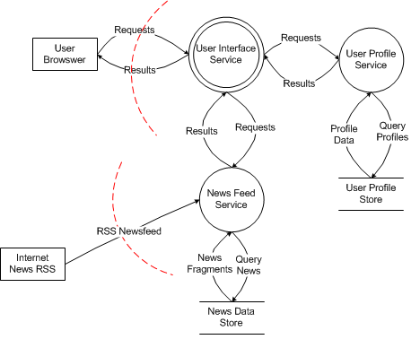
Diagram Type | Diagram Levels
Context | Highest level diagram. Identifies the major external actors for the service.
Level 0 | Identify the major processes
Level 1 | Detail the major processes
Level 2 | Security components and controls
Source: Chas Jeffries, Security Architect, Microsoft Services

Slide 13
Security Verification Testing
Automated as much as possible
openSCAP
ZED proxy
Code Climate
Others.
At -1 from production and in production.
Prior to release to production the security team receives a user story to run test on the integrated release. (Holistic test)
Automated scans and test for vulnerabilities with follow up manual testing.
Kali Offense

Slide 14
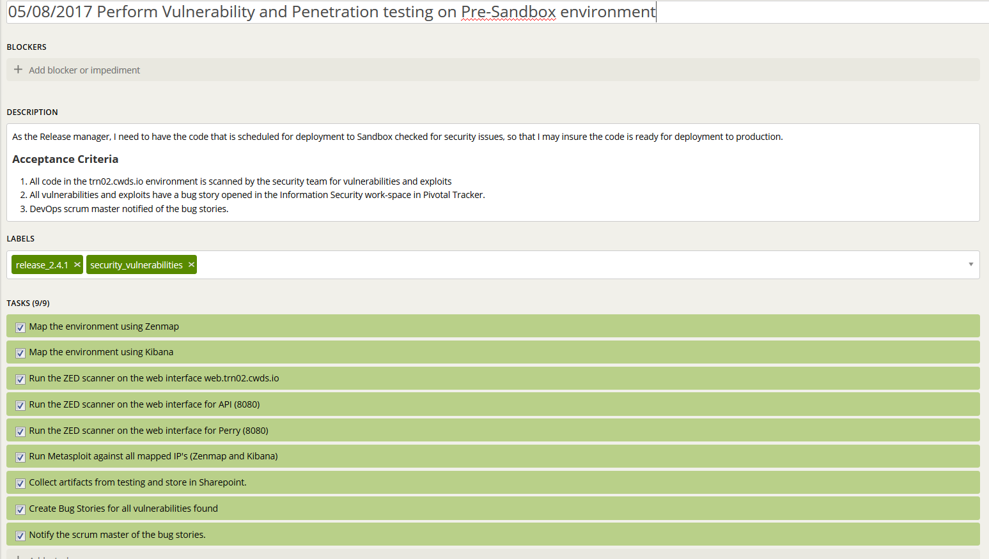

Slide 15
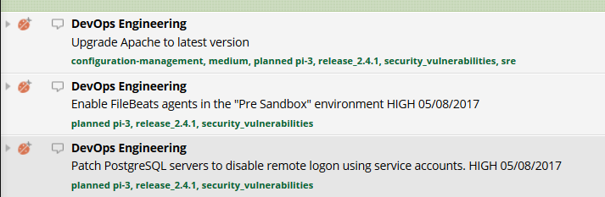
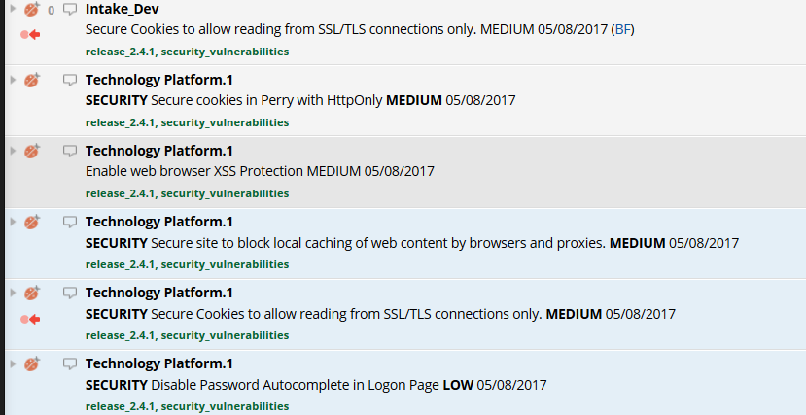

Slide 16
Design Review
Privacy Review – New or changes to data collection or use
Encryption – Changes in data in transit or data at rest
Access Controls – Identity and Access Management technology or process
Architecture changes – May drive a --
Attack Surface Analysis – changes or new capabilities, operational threats

Slide 17
Response Planning
Update Privacy Documents
Update FIPS 199 Inventory
Update Incidence Response Plan
Update the Technology Recovery Plan
Update the Systems Security Profile / Mitigation Documentation
Configuration Management

Slide 18
Defect
A defect (Bug) for Information Security is a confirmed vulnerability in a product that requires remediation.
A defect may be the result of a Penetration and Vulnerability Scan, developers peer review, automated testing, or another source.
A defect that cannot be resolved requires a Spike for research and analysis.
An Agile team may choose to send a defect to a spike immediately.

Slide 19
Spike
A spike is used to answer a question, or gather information
A spike for Information Security is appropriate when a risk is identified that will go through the process of documenting, classifying and assessing an security risk, or product defect.

Slide 20
Final Security Review
A Final Security Review (FSR) should be done at the end of every Agile sprint. The Agile team security advisor needs to review the following:
All every-sprint security requirements have been completed, or exceptions for those requirements have been granted.
At least one requirement from a security bucket category has been completed
No bucket requirement has gone more than six months without being completed
No one-time requirements have exceeded their grace period
No security bugs are open that fall above the designated severity threshold

Slide 22
Residual Risk and Risk Debt
Defects, vulnerabilities and risk that are not addressed in a sprint become Risk Debt.
Residual Risk is the risk that has been accepted by the Project using Risk Management.
Residual Risk must be tracked to insure that mitigation to mitigations are not being accumulated
Risk Debt must be managed to insure that he project does not accumulate to high of a debt.
Workload Management

Slide 23
Managing Workflow
Scrum, Scrumban, Kanban and ITIL
The Office of Information Security (OIS) will work in all types of workflow
The OIS will be both proactive and reactive to the development cycles
DevOps and OIS create environment as “fit for use”
As the project progresses, OIS and DevOps make the environment “fit for purpose”

Slide 25
Resources CWDS Website https://cwds.ca.gov Email comms@cwds.ca.gov

